Slide 1
“COVID-19 effects on language use by immigrants in Canada”
The project team:
Germany (ZAS): Natalia Gagarina, Olga Steriopolo
Canada
University of Alberta: Nedashkivska, Alla; Pankieiev, Oleksandr; Fatiushchenko, Vlada
University of Saskatchewan: Makarova, Veronika; Chirkov, Valery; Hladka, Sofiia; Hryshyna, Yuliia; Morozovskaia, Uliana.
University of Toronto: Lana Soglasnova
ZAS, Germany, February 20, 2024

Slide 2
Abstract This presentation reports some preliminary results of an interdisciplinary international research project “Sociocultural and language practices and needs of immigrant communities: the pandemic impact and post-pandemic recovery.” The study investigates an impact on COVID on communication by immigrants and patterns of information search during COVID. The results suggest that the distribution of languages in use was not very strongly affected by the pandemic. It was rather the shift in ftf vs live modalities that mattered: live communication decreased and online increased. Masks negatively affected communication. Participants had some problems learning COVID vocabulary in E and understood it better in the HL (Ukrainian).

Slide 3
1. Introduction
Uncertainties with finding COVID-19 related information in SK
Partnership with Dr. Professor Natalia Gagarina and Dr. Olga Steriopolo;
Partnership with Professors Alla Nedashkivska and Dr. Oleksandr Pankieiev
ACKNOWLEDGEMENTS:
NFRF grant (Canadian government)
Theoretical foundations: Engaged Scholarship (Van de Ven, 2007) and anti-Linguicism (Uecusa, 2019)

Slide 4
2. Project Goals
This project aims to examine the social impact of the COVID-19 pandemic and post-pandemic transition on language practices among the Ukrainian and Russian-speaking migrants residing in Canada (Saskatchewan and Alberta) and Germany. The project also investigates the linguistic patterns of emergency information access by immigrants drawing on COVID-19 example. The study focuses on two key areas:
the effects of COVID-19 on communication in immigrant communities (Russian and Ukrainian speakers)
an evaluation of the patterns of information search by immigrants in crisis.

Slide 5
3. Literature Review Language balance is “central to any immigrant group” (Isurin, 2011, p. 21), as it impacts one’s identity construction, self-esteem, intellectual engagement, and cognitive abilities (Alisaari et al., 2021; van den Noort et al., 2019). Majority language proficiency is essential to find a job, get access to social welfare and medical services, conduct everyday tasks and prevent mental illness (Adversario, 2021; Dustmann & Fabbri, 2003; Ventriglio et al., 2021). Incorrect use of the majority language or speaking one’s first language in public could subject immigrants to “linguistic racism” (or linguicism, i.e. linguistic homogeneity-based discrimination), alienation (Dovchin, 2019, p. 334), and anxieties (Sevinç & Backus, 2019)

Slide 6
3. Literature Review Maintaining immigrant languages and cultures is also beneficial (integration or biculturalism/bilingualism in Berry’s 1970 Acculturation model). Multilingualism influences identity (Siebenhutter, 2023) The HL has an impact on the emotions of its speaker (Thoma, 2023). HL helps to build family ties and communicate across generations (Curdt-Christiansen and Huang, 2020). Excessive orientation towards the host culture can be directly related to depression among immigrants (Starck et al., 2020).

Slide 7
3. Literature Review
COVID19 has been described as “the greatest contemporary global health, economic, and social challenge for humankind” (Bhandari et al., 2021, p. 9).
COVID-19 disrupted communication within immigrant communities, which is an important factor in minority language and culture maintenance as well as in the well-being of immigrants (Meddegama, 2020; Oriyama, 2010).
Immigrants and refugees were declared a highly vulnerable groups by WHO in 2020 partly based on the language barrier (Leung et al., 2023

Slide 8
3. Literature Review
Due to language barriers, immigrants felt disadvantaged in accessing vital pandemic information (Demeke et al., 2022).
Linguistic minorities find themselves excluded from “timely high-quality information” (Piller & Zhang, 2020)
These barriers included insufficient knowledge of the pandemic vocabulary (Bhandari et al., 2021; Pandey et al., 2021; Zlotnick et al., 2021).
Some changes in family home language policies have been reported, such as shifts to the majority language in Asian communities due to a surge of anti-Asian racism during COVID-19 (Wei, 2021).

Slide 9
4. Materials and Methods 4.1. Overall Design A mixed (quantitative and qualitative) methods approach combining an online sociolinguistic/sociocultural survey with interviews. The surveys are analyzed quantitatively (with a qualitative component). Only some descriptive statistics are presented today. The interviews will be analyzed qualitatively through qualitative thematic analysis with NVivo. In this presentation, I can only report some preliminary survey results.

Slide 10
4. Materials and Methods 4.2. Participants (43). Q-re for Ukrainian speakers in Ukrainian and English (110 Questions). Province: AB=30, SK=12, ON=1 Country of origin: Ukraine=42, USA=1 Age: 38.6 (StDev=8.26, Min =20, Max=59) Gender: F=33, M=12, do not want to disclose=1, other=0. First language: Ukrainian=36, Russian =7 Second language: Russian=20, English=12, Ukrainian =6, Russ+Engl=1, Ukr+Engl=1, German=1, French=1, Polish=1

Slide 11
4. Materials and Methods 4.2. Participants EDI groups
EDI group | N | Percent
Ethnic m | 6 | 13.3
Religious m | 6 | 13.3
Racial m | 1 | 2.2
Linguistic m | 2 | 4.4
Disabled | 1 | 2.2
LGBTQ+ | 5 | 11.1
none | 32 | 71.1
other | 2 | 4.4

Slide 12
Ethnicity | Number | Percent
Ukrainian | 36 | 80
Ukrainain Slavic | 1 | 2.2
Ukrainian-Russian | 1 | 2.2
Slavic (Sloviani) | 1 | 2.2
white | 1 | 2.2
European | 1 | 2.2
Canad, Ukr Backgr | 1 | 2.2
Ukrainian Canadian | 1 | 2.2
Ukr Greek Catholic | 1 | 2.2
Caucasian | 1 | 2.2
total | 43 | 100
4. Materials and Methods
4.3. Participants’ ethnic self-identification

Slide 13
Family status | number | percent
single | 4 | 8.8
married | 38 | 84.4
divorced | 0 | 0
partner | 4 | 8.8
single | 0 | 0
4. Materials and Methods
4.4. Participants’ family status

Slide 14
employment type | number | percent
FT outside | 25 | 55.5
FT home | 3 | 6.6
PT outside | 11 | 24.4
PT home | 5 | 11.1
Homemaker | 3 | 6.6
unemployed | 1 | 2.2
undergrad st | 2 | 4.4
grad st | 2 | 4.4
professional course | 1 | 2.2
retired | 0 | 0
other | 2 | 4.4
4. Materials and Methods
4.5. Participants’ employment

Slide 15
Education level | number | percent
did not study | 1 | 2.1
secondary school | 3 | 6.5
technical | 4 | 8.6
Bachelor's | 12 | 26
Master's | 16 | 34.7
PhD | 5 | 10.8
other | 5 | 10.8
4. Materials and Methods
4.6. Participants’ education

Slide 16
entry status | number | percent
refugee | 0 | 0
PR | 11 | 23.9
spousal visa | 0 | 0
working visa | 27 | 58.6
student visa | 5 | 10.8
Prefer not to disclose | 0 | 0
other | 3 | 6.5
4. Materials and Methods
4.7. Participants’ entry status

Slide 17
reasons for immigration | number | percent
economic | 19 | 41.3
political | 9 | 19.5
escape war | 11 | 23.9
escape internal conflicts | 6 | 13
escape crime & violence | 6 | 13
discrimination | 2 | 4.3
came to study & stayed | 6 | 13
better opportunities for myself | 24 | 52.1
better opportunities for my children | 15 | 32
searching for a better job | 9 | 19.5
just happened so | 4 | 8.6
married a Canadian | 2 | 4.3
for children not to serve in the army | 1 | 2.1
my parent's decision | 4 | 8.6
to reunite with relatives | 4 | 8.6
prefer not to say | 1 | 2.1
other | 1 | 2.1
4. Materials and Methods
4.8. Participants’ reasons for
immigration

Slide 18
5. Results 5.1. Integration in Canada

Slide 19
5. Results
5.2. Language use in Canada
What is the amount of your daily interactions in different languages (0-100%)?
Ukrainian =60.7%
English =45.6%
Russian=6.9%

Slide 20
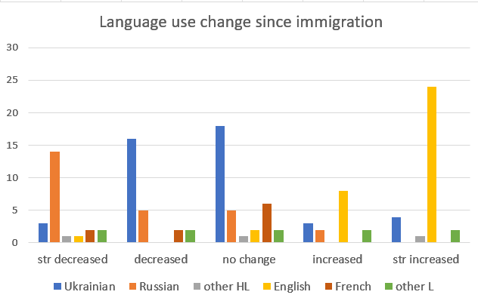
How has your language use changed since immigration?
5. Results
5.2. Language use in Canada

Slide 21
On a scale of 1 to 10, How strongly did COVID disrupt your normal life? Average: 6.63 (STDev+2.54; min= 1, max=10) How strong was your level of anxiety for yourself and the loved ones not to catch COVID? Average: 5.77 (StDev=2.61, min=1.9, max=10)
5. Results 5.3. COVID

Slide 22
While in Canada between 2020-22, did you have any problems understanding COVID restrictions, vaccinations procedures and other COVID-related information?
5. Results 5.3. COVID
Frequency | N | precent
all the time | 1 | 2.3
frequent | 2 | 4.6
occasional | 7 | 16.2
a few | 12 | 27.9
none | 21 | 48.8
total | 43 | 100

Slide 23
5. Results 5.3. COVID What type of information did you look for?
Information type | number | percent
infection rates | 26 | 60.4
death rates | 23 | 53.4
masks | 20 | 46.5
social distancing | 15 | 34.8
vaccinations | 26 | 60.4
vaccine type and their availability | 17 | 39.5
vaccine side effects | 21 | 48.8
vaccine boosters | 7 | 16.2
scheduling vaccination appointments | 12 | 27.9
scheduling boosters appointments | 7 | 16.2
long-term effects of COVID | 19 | 44.1
work or classes ftf/online trasitions | 23 | 53.4
other | 3 | 6.9

Slide 24
5. Results 5.3. COVID What were the
reasons for
problems with
finding COVID
information>?
Reasons for problems | Number | percent
insufficient knowledge of E or Fr | 4 | 9.3
lack of confidence in E/Fr skills | 3 | 6.9
lack of publicly available information | 7 | 16.2
insufficient information | 10 | 23.2
not knowing where to find information | 7 | 16.2
confusing or contradictory information | 12 | 27.9
no problems | 15 | 34.8
other reasons | 2 | 4.6

Slide 25
Canad TV | 15 | 34.8
Canad online newspapers | 9 | 20.9
Other Canad media | 4 | 9.3
Canad local gov | 19 | 44.1
Canad local municipality | 5 | 11.6
Social Media | 20 | 46.5
my friends | 18 | 41.8
Media in my home country | 7 | 16.2
internet in Canada | 23 | 53.4
Internet in my home country | 8 | 18.6
local public library | 0 | 0
univ/college library | 1 | 2.3
other library | 1 | 2.3
none(did not look) | 1 | 2.3
Other sources | 4 | 9.3
5. Results 5.3. COVID In what languages did you
search for COVID information?
English=24,
Ukr+Eng=13,
Ukr=2,
Eng+Ukr+Russ=1,
Internet =1
In what sources did you search
for COVID information?

Slide 26
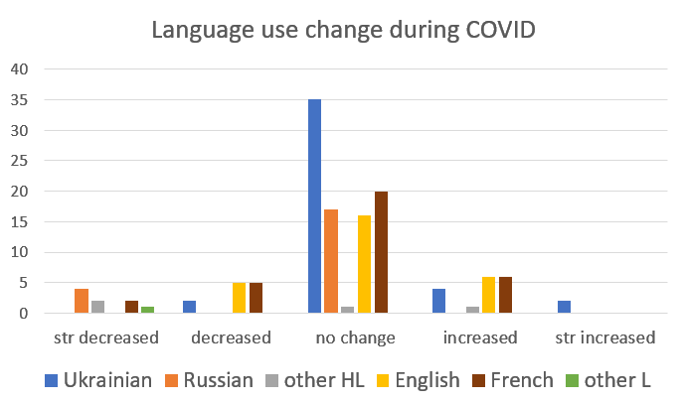
5. Results 5.3. COVID

Slide 27
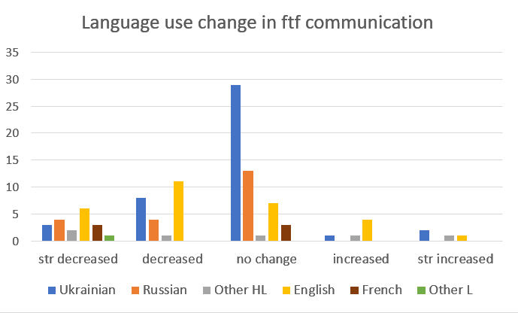
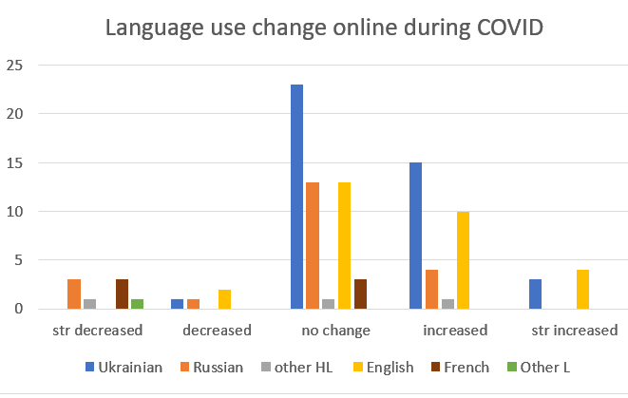
5. Results 5.3. COVID

Slide 28
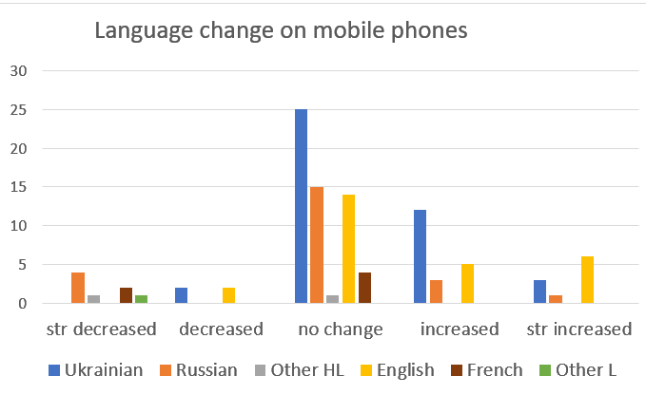
5. Results 5.3. COVID

Slide 29
5. Results 5.3. COVID How did your language use change during COVID?
Less communication
Can't communicate with them face-to-face so often as before - COVID restrictions.
COVID significantly decreased face-to-face communication. As I am not a big fan of media interactions I found it hard on me. Even though technically my language usage was not affected, the quality and expectations from communication strongly decreased.
The online communication has increased and face - to - face interactions decreased a lot
Increased over the phone using Ukrainian and English
More over the phone and internet messengers
People were paranoid to get together. They were brainwashed to not meet with people and God forbid you stood closer then 5 meters.
English use decreased.

Slide 30
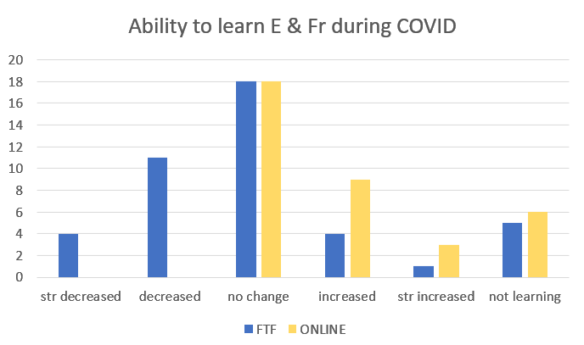
5. Results 5.3. COVID

Slide 31
5. Results 5.3. COVID
Written language due to using Teams at work
I started using my writing skills more often which affected my vocabulary and grammar. Digital learning provided practice of the skills to help me improve English
Not much - just increased time spent for online studying, but it was not English language
By Looking for information myself online
Because everything was shifted online, it felt like I had more interaction with people online than prior COVID.

Slide 32
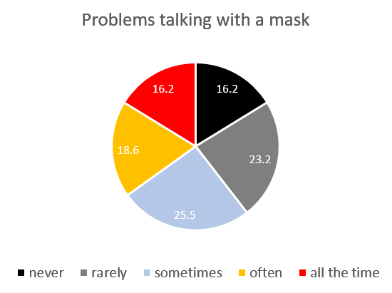
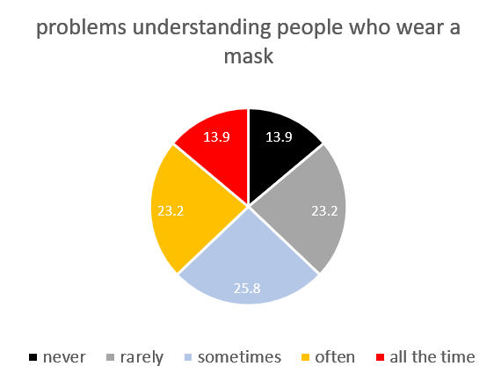
5. Results 5.4. COVID-masks

Slide 33
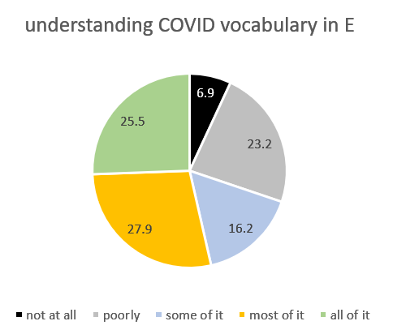
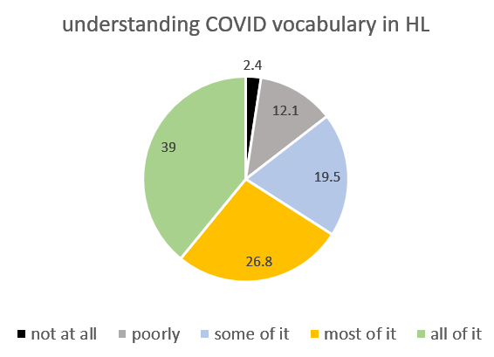
5. Results 5.4. COVID-masks

Slide 34
6. DISCUSSION The pandemic did not change anything radically in terms of balances between languages. It only caused modality shift. For Ukrainian speakers in Canada, we observe a strong position of Ukrainian and a weakening of Russian use (similarly to many other locations where the shift was caused by the war). Ukrainian speakers do not see themselves as being disadvantaged due to lack of information in Ukrainian (contrary to early findings for other groups, e.g., Demeke et al., 2022)

Slide 35
7. Conclusions
Problems with finding COVID information were related to confusing or contradictory information, insufficient information, lack of publicly available information, not knowing where to find information.
The most widely used sources of COVID information search were Internet in Canada, Social media, Canadian local governments’ sites, and one’s friends
Language use decreased in ftf (live) modality and increased in online modality (a trade-off effect)
Language use on i-phones and apps increased somewhat.
Opportunities to learn E &Fr decreased in live modality and increased in online modality
Masks disrupt communication
Understanding of COVID-related vocabulary is better in the HL than in E.

Slide 36
7. CONCLUSIONS To learn the lessons from the past and prepare for future emergencies, multilingual crisis communication needs to be advanced (Piller et al., 2020). Canada still remains in the clutches of a disparity between multiculturalism and mythological bilingualism policy.

Slide 37
References Bhandari, D., Kotera, Y., Ozaki, A. et al. COVID-19: challenges faced by Nepalese migrants living in Japan. BMC Public Health 21, 752 (2021). https://doi.org/10.1186/s12889-021-10796-8 Curdt-Christiansen X. L., Huang J. (2020). Factors influencing family language policy. In Schalley A., Eisenchlas S. (Eds.), Handbook of Applied Linguistic Series: Social and affective factors in home language maintenance and development (pp. 174–193). Mouton De Gruyter. Demeke, J., McFadden, S. M., Dada, D., Djiometio, J. N., Vlahov, D., Wilton, L., Wang, M., & Leung D, Lee C, Wang AH, Guruge S. Immigrants' and refugees' experiences of access to health and social services during the COVID-19 pandemic in Toronto, Canada. J Health Serv Res Policy. 2023 Jan;28(1):34-41. doi: 10.1177/13558196221109148. Epub 2022 Aug 15. PMID: 35971256; PMCID: PMC9382571. Nelson, L. E. (2022). Strategies that promote equity in COVID-19 vaccine uptake for undocumented immigrants: a review. Journal of Community Health, 3, 554–562. Meddegama I. V. (2020). Cultural values and practices: The pillars of heritage language maintenance endeavours within an immigrant multilingual Malayali community in the UK. International Journal of Bilingual Education & Bilingualism, 23(6), 643–656.

Slide 38
Oriyama, K. (2010). Heritage Language Maintenance and Japanese Identity Formation: What Role Can Schooling and Ethnic Community Contact Play?. Heritage Language Journal, 7(2), 237-272. https://doi.org/10.46538/hlj.7.2.5 Pandey, K., Parreñas, R. S., & Sabio, G. S. (2021). Essential and Expendable: Migrant Domestic Workers and the COVID-19 Pandemic. American Behavioral Scientist, 65(10), 1287-1301. https://doi.org/10.1177/00027642211000396 Piller, I, Zhang, J. (2020). Li, Jia. "Linguistic diversity in a time of crisis: Language challenges of the COVID-19 pandemic" Multilingua, vol. 39, no. 5, 2020, pp. 503-515. https://doi.org/10.1515/multi-2020-0136 Siebenhütter, S. (2023). The multilingual profile and its impact on identity: Approaching the difference between multilingualism and multilingual identity or linguistic identity. Ampersand. 10 100123. https://doi.org/10.1016/j.amper.2023.100123 Stark, A., Gutermann, J., Schouler-Ocak, M, Jesuthasan, J., Bongard, S. andStabgier, U. (2020). The relationship of acculturation, traumatic events and depression in female refugees. Frontiers of Psychology. Thoma, D. (2023). Language-dependent emotions in heritage and second language bilinguals: When physiological reactions deviate from feelings. International Journal of Bilingualism, 0(0). https://doi.org/10.1177/13670069231159840

